Slide 1

Clickety, Click, Clique!!!
Jorge Serrano
Jessica Parker
Charles Descheneaux
Jennifer Bowling
Joyce Ghali
Justin Mangaroo

Slide 2
Purpose
The purpose of this project is to examine the population of the world, by looking at each country, individually. We will view the population, growth rate, and density of these countries using our dashboard.

Slide 3
Applications Used
SQL LITE - stores world country data
Leaflet - map display
Plotly - bar & line graphs
Geojson - geographical coordinates
Flask api - pulls data and makes accessible
Javascript - coding
Html - dashboard
Css - visually appealing
D3 - query the data

Slide 4
Sources
Data Source: https://www.kaggle.com/datasets/rajkumarpandey02/2023-world-population-by-country
Geojson Data: https://raw.githubusercontent.com/nvkelso/natural-earth-vector/master/geojson/ne_110m_admin_0_countries.geojson
Dashboard background: https://media.istockphoto.com/id/862480656/vector/abstract-world-map-blue-map-of-the-earth-from-the-square-points-dark-background-blue-glow.jpg?s=612x612&w=0&k=20&c=MhiXx71esxaAVNl1sIwRTsFZ9lMTgZhQal8RJWKZSaE=
Project Help: https://www.w3schools.com

Slide 5
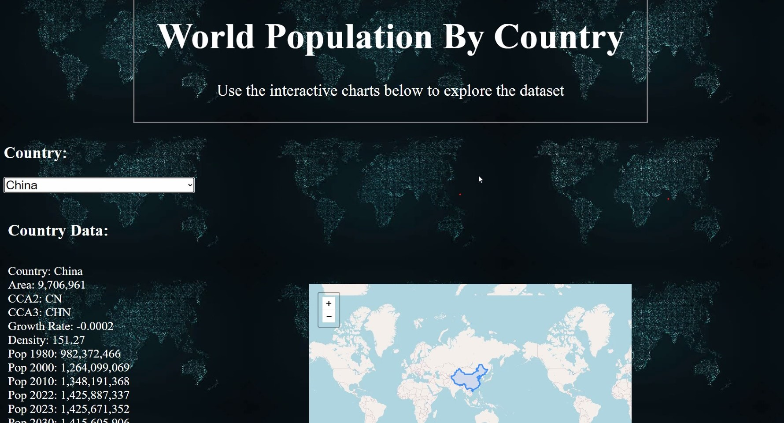
Dashboard

Slide 6
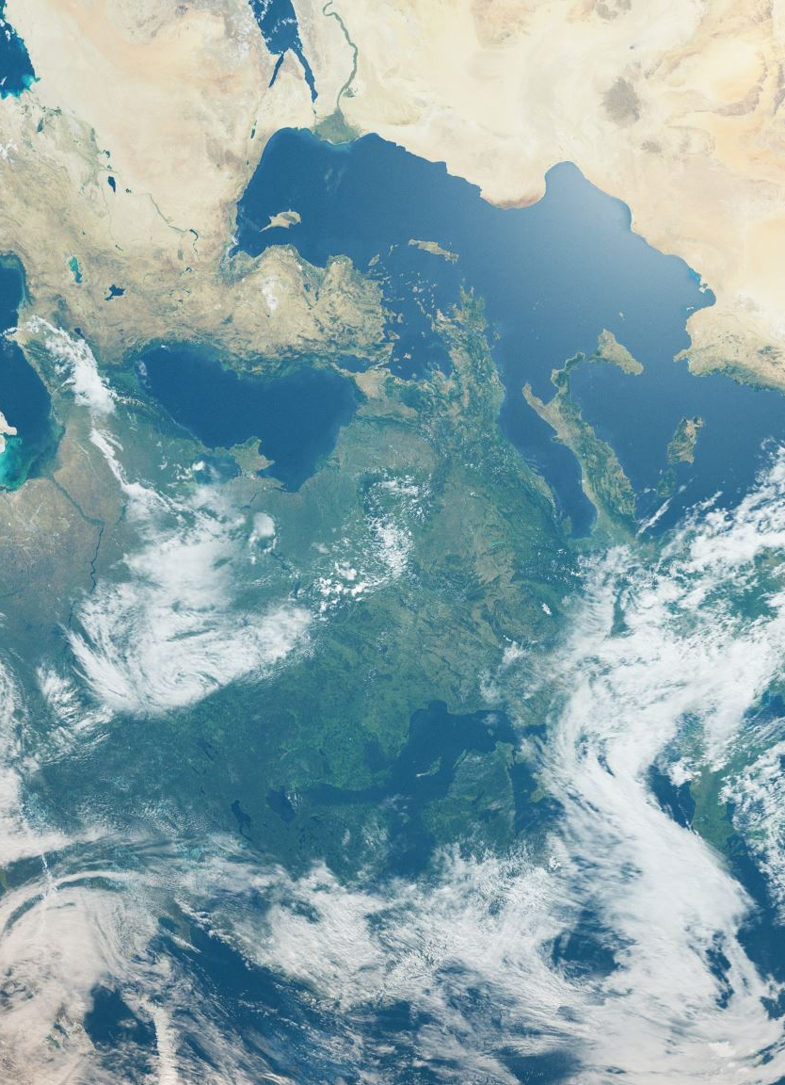
Website Navigation
Drop-down – displays all the countries of the dataset
Bulleted Demographics – displays data that is specific to the selected country
World Map – displays geographical locations of the selected country
Bar Chart – displays the population of the selected country
Line Chart – displays the growth rate of the selected country
Flask API – allows one to retrieve all data

Slide 7
Challenges
Deciding on a dataset( we went from changes of lego colors, video games, music, Disney movies, and then we settled on World Population.
Had difficulties importing our dataset
Using the data to create the drop-down that allowed each country to be selected
Filtering the dataset to display each country’s demographics
Creating the maps and graphs
Making the dashboard visually appealing

Slide 8

Thank You !!

